Slide 1


Data Analyst Internship
Task: HR Data Analysis
Name: Kirthik Ramadoss
Email: kirthikramadoss07@gmail.com

Slide 2
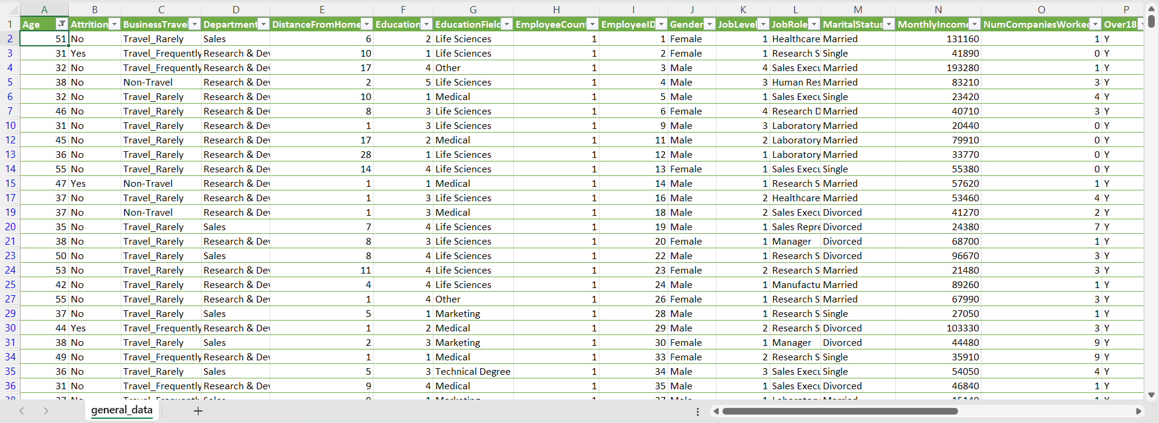
1. Using Excel, how would you filter the dataset to only show employees aged 30 and above?

Slide 3
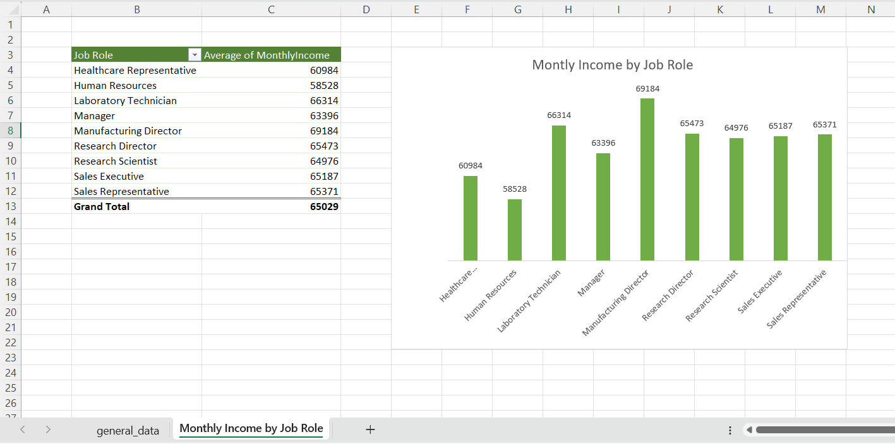
2. Create a pivot table to summarize the average Monthly Income by Job Role.

Slide 4
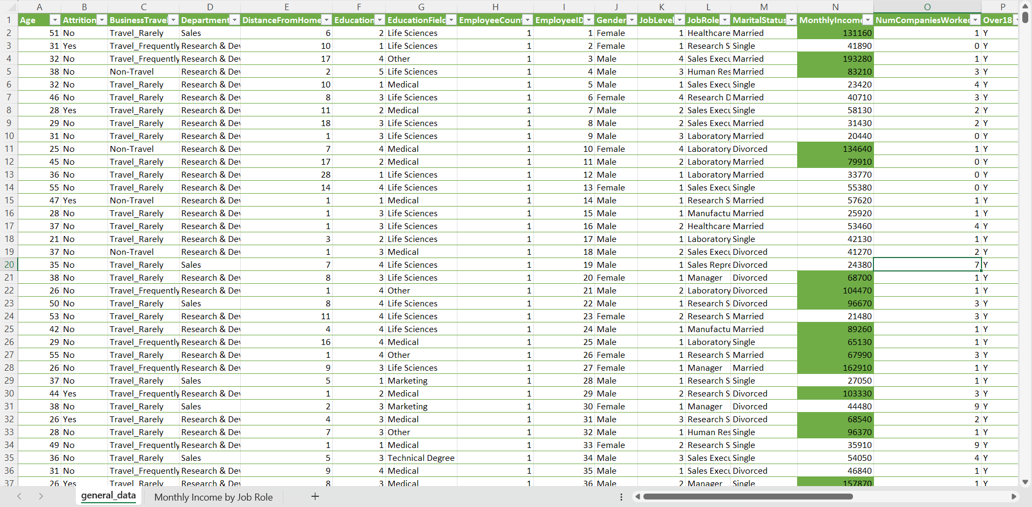
3. Apply conditional formatting to highlight employees with Monthly Income above the company's average income.

Slide 5
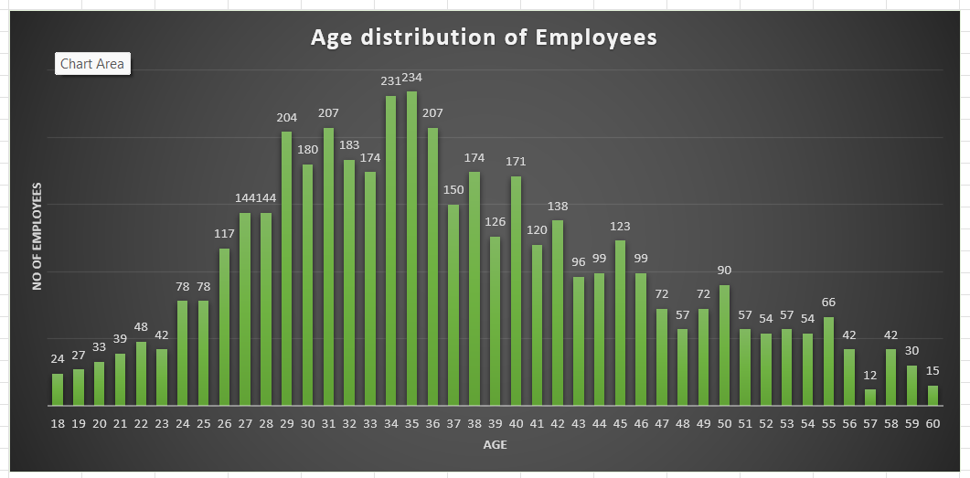
4. Create a bar chart in Excel to visualize the distribution of employee ages.

Slide 6
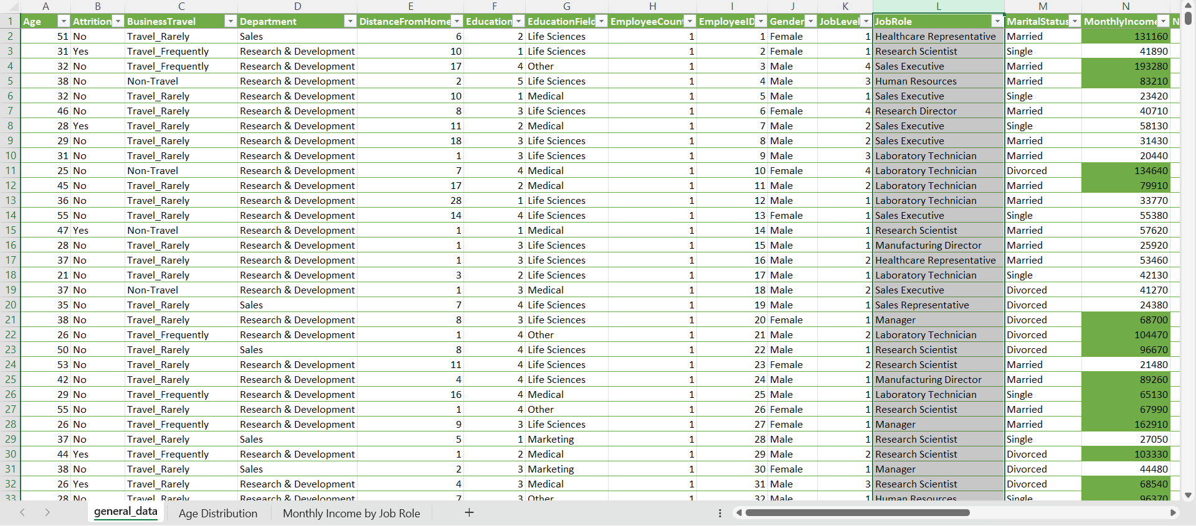
5. Identify and clean any missing or inconsistent data in the "Department" column.

Slide 7
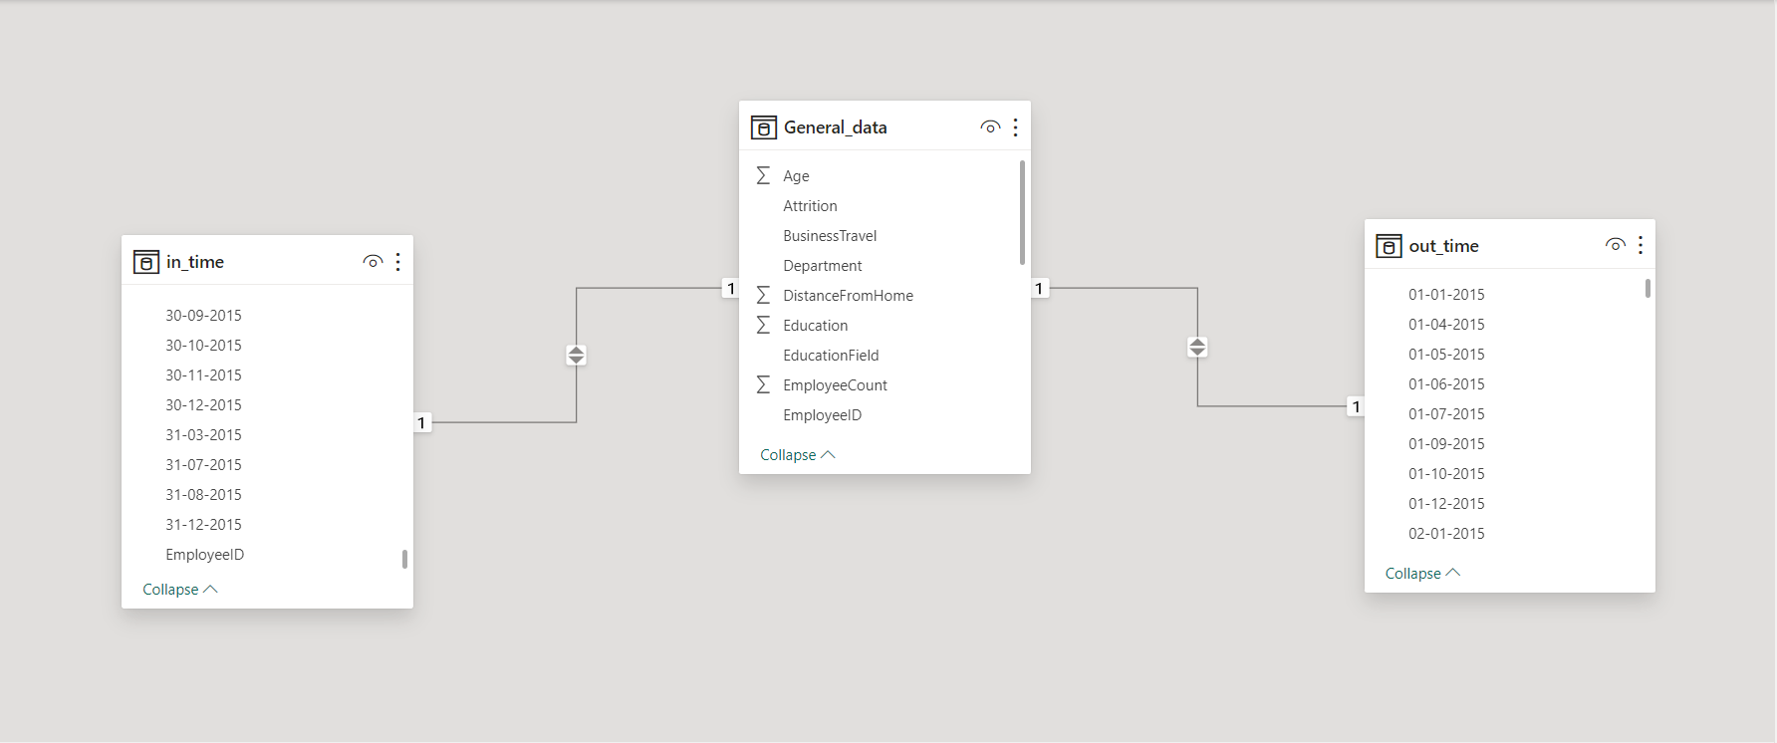
6. In Power BI, establish a relationship between the "EmployeeID" in the employee data and the "EmployeeID" in the time tracking data.

Slide 8
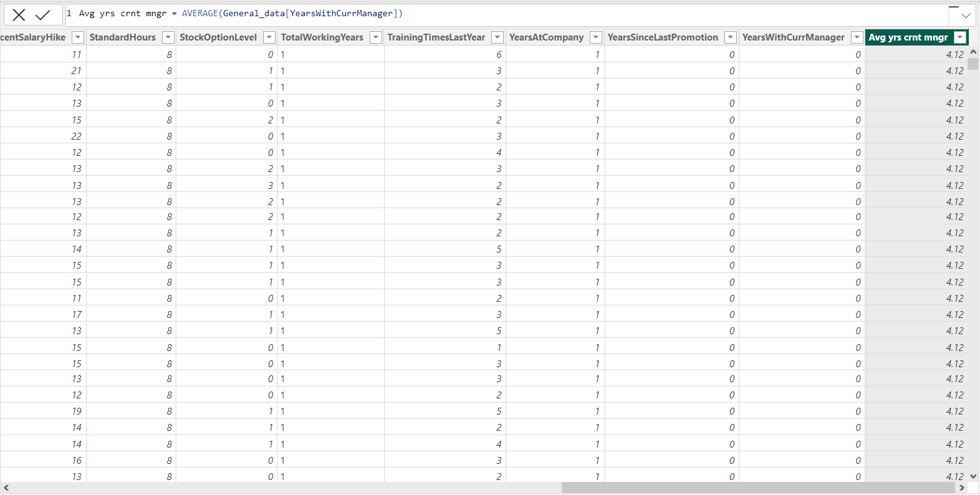
7. Using DAX, create a calculated column that calculates the average years an employee has spent with their current manager.

Slide 9
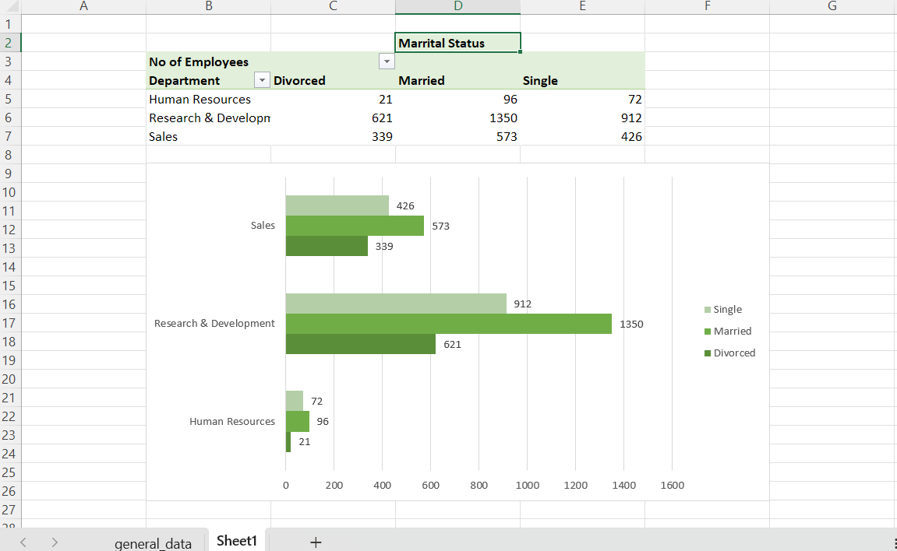
8. Using Excel, create a pivot table that displays the count of employees in each Marital Status category, segmented by Department.

Slide 10
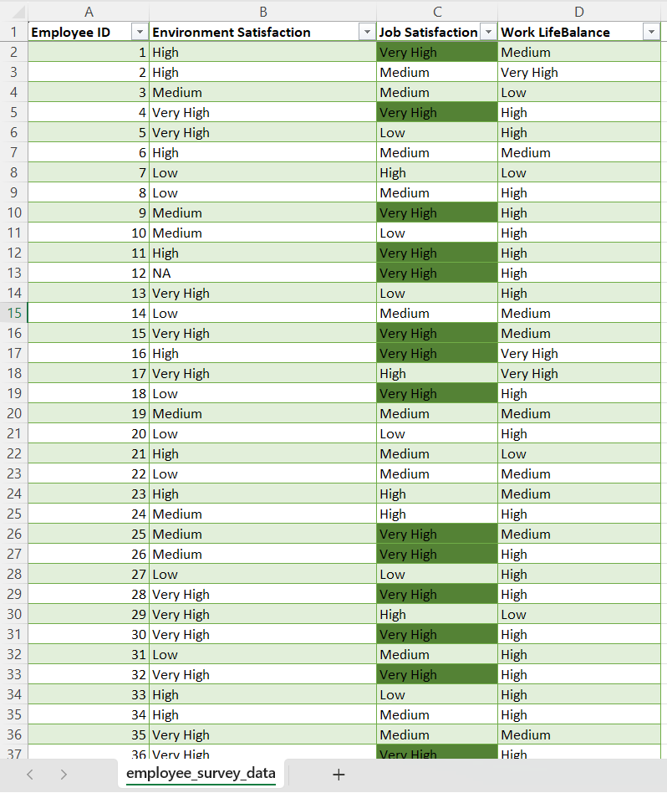
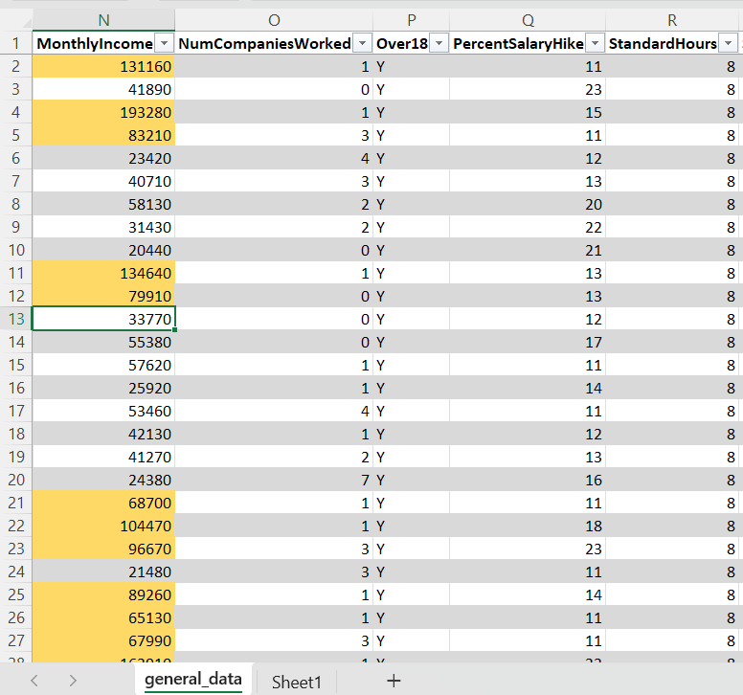
9. Apply conditional formatting to highlight employees with both above-average Monthly Income and above-average Job Satisfaction.

Slide 11
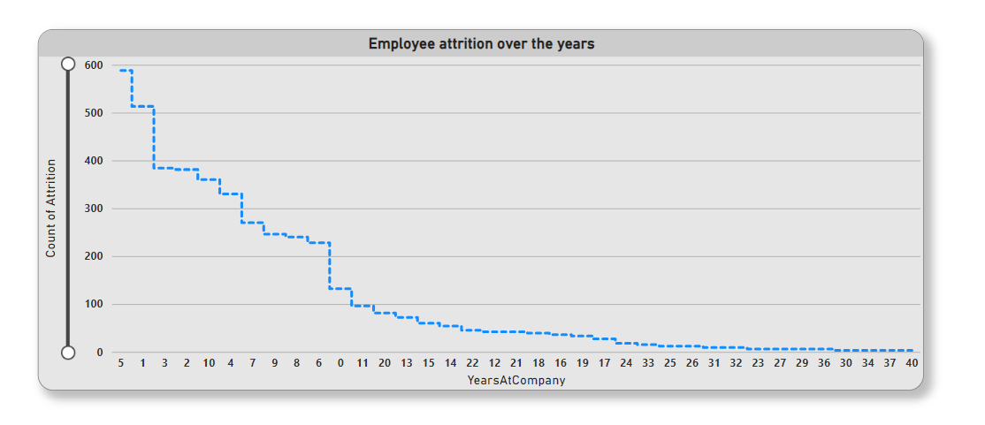
10. In Power BI, create a line chart that visualizes the trend of Employee Attrition over the years.

Slide 12
11. Describe how you would create a star schema for this dataset, explaining the benefits of doing so.
A star schema is a database design where a central fact table is connected to multiple dimension tables through well-defined relationships.
Below are the steps I follow to create the star schema.
Create Fact Table: Identify the main fact table representing core data (e.g., General Data).
Define Dimension Tables: Surround the fact table with dimension tables, each focusing on specific attributes (e.g., Attrition, Job role, Department).
Establish Relationships: Connect the fact table to dimension tables through relationships (e.g., employee ID matching between tables).
Simplify Data Navigation: Users can efficiently navigate and analyze data by easily joining tables through well-defined relationships.
Reduce Redundancy: The structure reduces redundancy by breaking down data into distinct fact and dimension tables.
Optimize Query Performance: The star schema improves query performance, allowing for quicker access to information without complex joins.
Enhance Maintainability: The clear structure facilitates a better understanding of data relationships, improving overall database maintainability.
Beneficial for BI Tools: Particularly advantageous for business intelligence and reporting tools like Power BI, enabling seamless data exploration and visualization.

Slide 13
12. Using DAX, calculate the rolling 3-month average of Monthly Income for each employee.
Rolling 3-Month Avg =
CALCULATE(AVERAGE('Your TableName' [Monthly Income]),
FILTER(ALL('Your TableName"),
"Your TableName' [EmployeeID] =
EARLIER('YourTableName' [EmployeeID]) &&
'Your TableName'[Date] <=
EARLIER('Your TableName' [Date]) &&
'Your TableName' [Date] >
DATEADD(EARLIER("Your TableName' [Date]), -3,MONTH)))

Slide 14
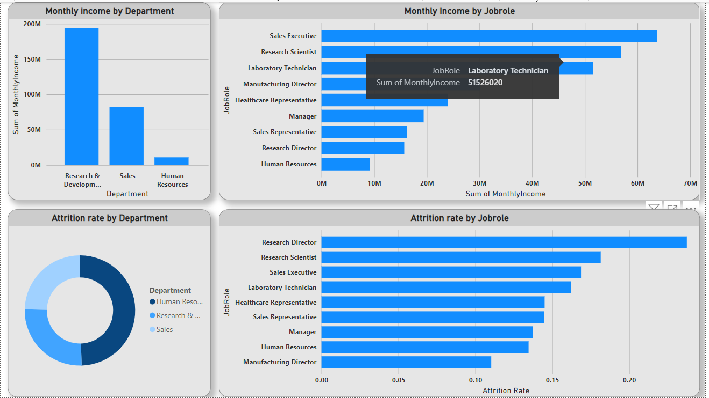
13. Create a hierarchy in Power BI that allows users to drill down from Department to Job Role to further narrow their analysis.

Slide 15
14. How can you set up parameterized queries in Power BI to allow users to filter data based 2 of 2 on the Distance from Home column?
To set up parameterized queries in Power BI for filtering data based on the Distance from Home column, follow these steps:
Create a Parameter: In Power BI Desktop, go to the "Home" tab and click on "Manage Parameters.“ Create a
new parameter (e.g., DistanceParameter) with a default value and choose Decimal Number as the data type.
2. Modify the Query: Go to the Power Query Editor by clicking "Transform Data.“ Find your data loading query and add a step to filter the data based on the Distance from Home column using the parameter.
m = Table.SelectRows(YourPreviousStep, each [DistanceFromHome] <= DistanceParameter)
3. Apply Changes: Close and apply changes in the Power Query Editor. In the main Power BI Desktop window, go to the "Home" tab and click "Close & Apply.“
4. Add a Slicer or Input Field: In the report view, add a slicer or input field to the canvas. Connect the slicer or input field to the DistanceParameter by selecting it in the "Visualization" pane.
5. Test the Parameter: Switch to "View" mode to test the report. Use the slicer or input field to adjust the distance parameter, dynamically updating the report based on user input.

Slide 16
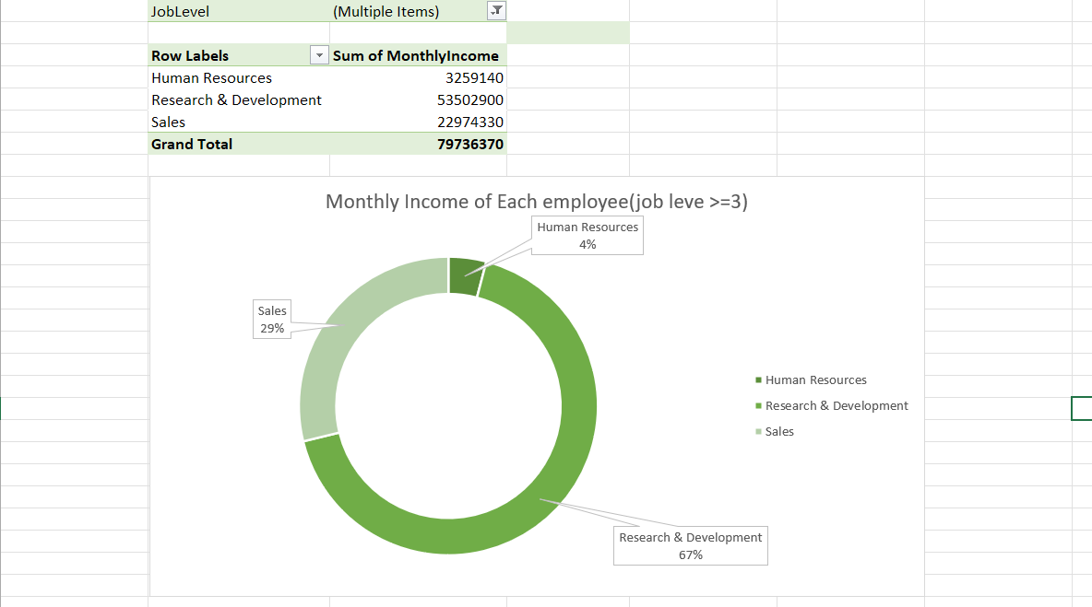
15. In Excel, calculate the total Monthly Income for each Department, considering only the employees with a Job Level greater than or equal to 3.

Slide 17
16. Explain how to perform a What-If analysis in Excel to understand the impact of a 10% increase in Percent Salary Hike on Monthly Income.
Ans: Performing a What-If analysis in Excel to understand the impact of a 10% increase in Percent Salary Hike on Monthly Income involves two steps.
First, set up your Excel sheet with columns for current Monthly Income, Percent Salary Hike, and the calculated New Monthly Income. Enter the initial values in these cells. Then, use Excel's Goal Seek feature. Select the cell with the New Monthly Income, go to the "Data" tab, click on "What-If Analysis," and choose "Goal Seek." Set the target value (original income plus 10%) and instruct Excel to adjust the Percent Salary Hike cell to achieve the goal. Excel will show you the adjusted percentage, allowing you to understand the impact of the 10% increase on Monthly Income.
After running Goal Seek, review the results to see how the Percent Salary Hike changes to achieve the desired New Monthly Income. This analysis helps you grasp the impact of a 10% raise on Monthly Income without manually recalculating. It's a handy way to explore different scenarios and understand how changes in one variable affect others in your Excel model.

Slide 18
17. Verify if the data adheres to a predefined schema. What actions would you take if you find inconsistencies?
Verifying if the data adheres to a predefined schema involves checking if it conforms to the expected structure, data types, and relationships outlined in the schema. If inconsistencies are found, the following actions can be taken:
Data Cleaning:
1. Correct types and inconsistencies.
2. Handle missing values (eg. imputation, deletion)
3. Validate data types and formats.
Schema Adjustment:
1. Consider updating the schema if it's overly restrictive or doesn't accurately reflect the data's nature
2. Reshape data to conform to the schema if necessary.
3. Exclude problematic data if it can't be reliably corrected

Slide 19
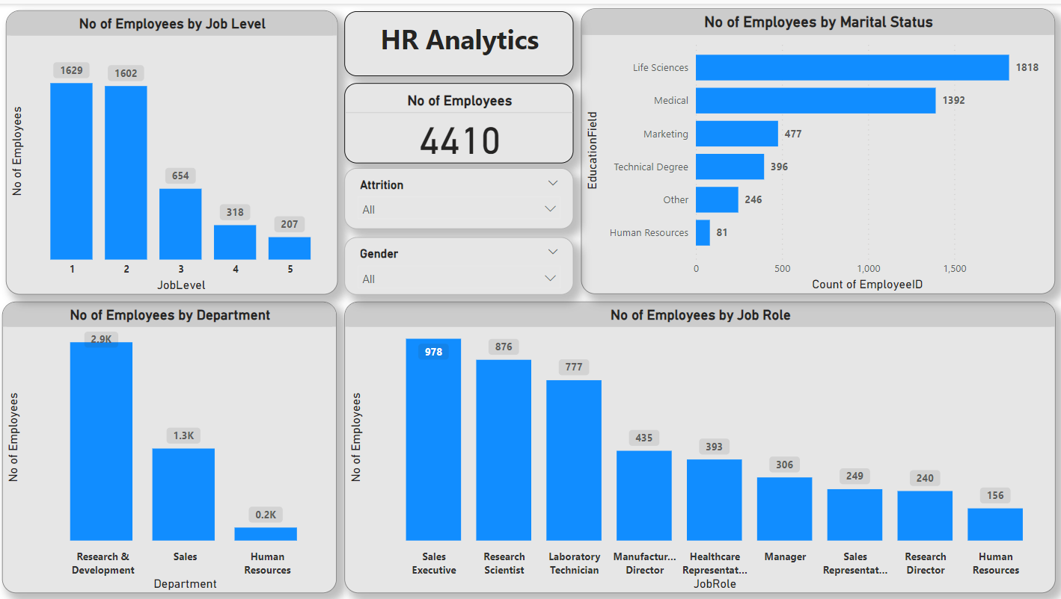

Slide 20
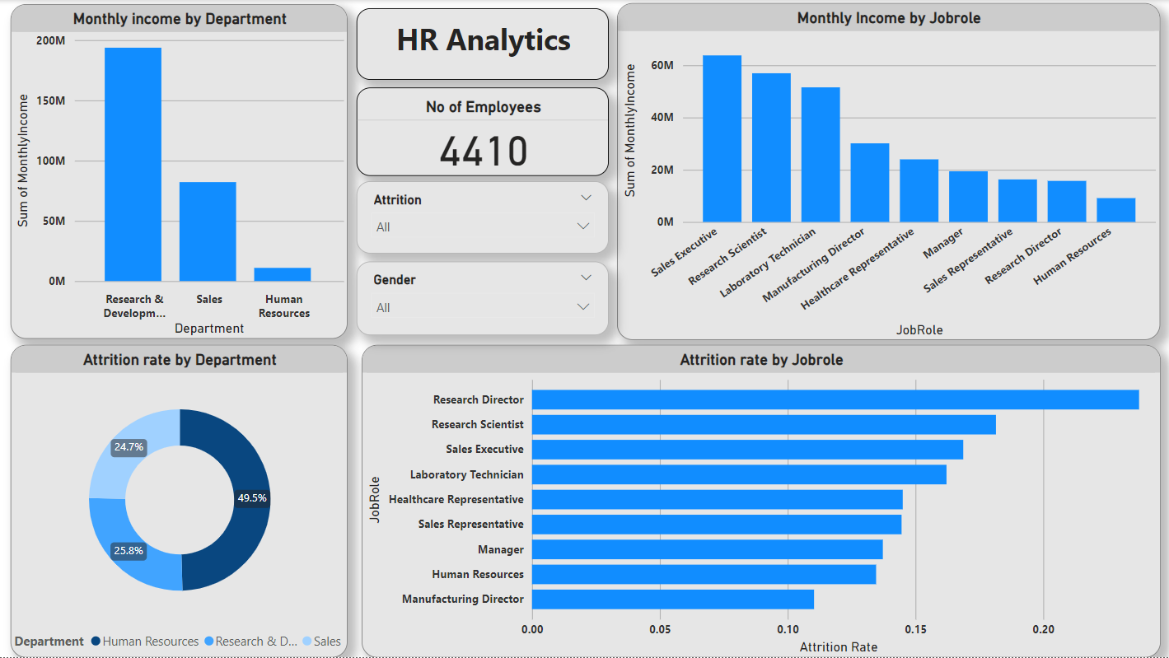

Slide 21
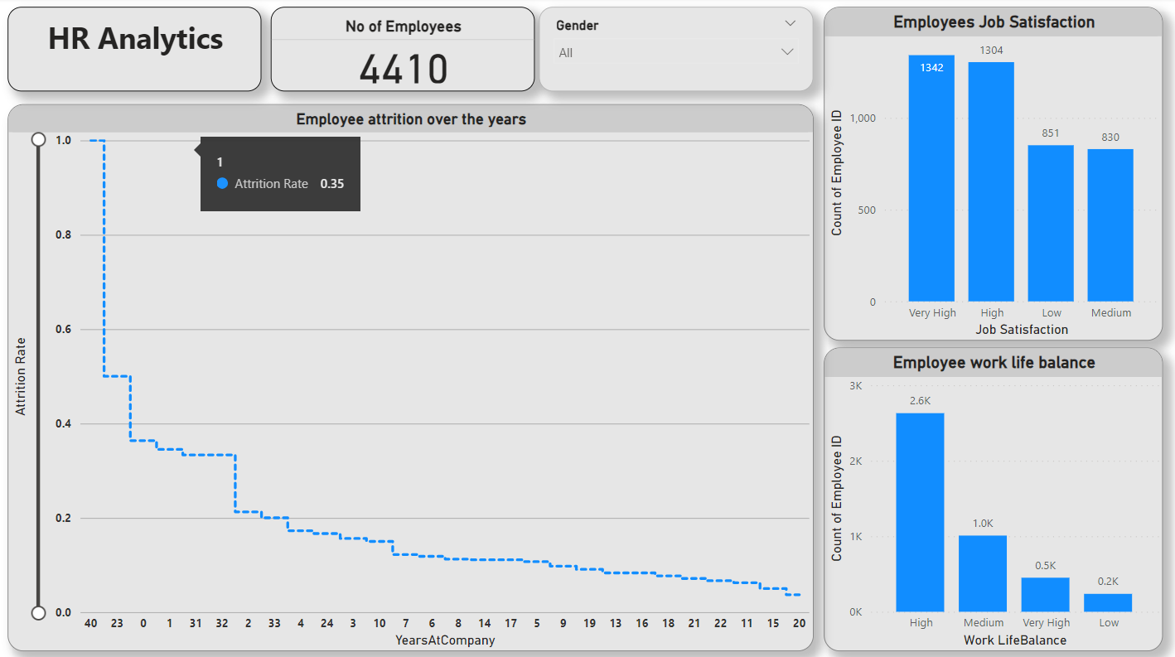

Slide 22


